Slide 1
current affairs video
Name
Course title
Date

Slide 2
Is traveling to the us safer after vaccine?
Further testing needed to be done especially in schools
Resources are set to facilitate the test and should not be channeled to other activities.
Hence it was not the best time to travel across the country.
The speaker uses deductive reasoning to present his arguments

Slide 3
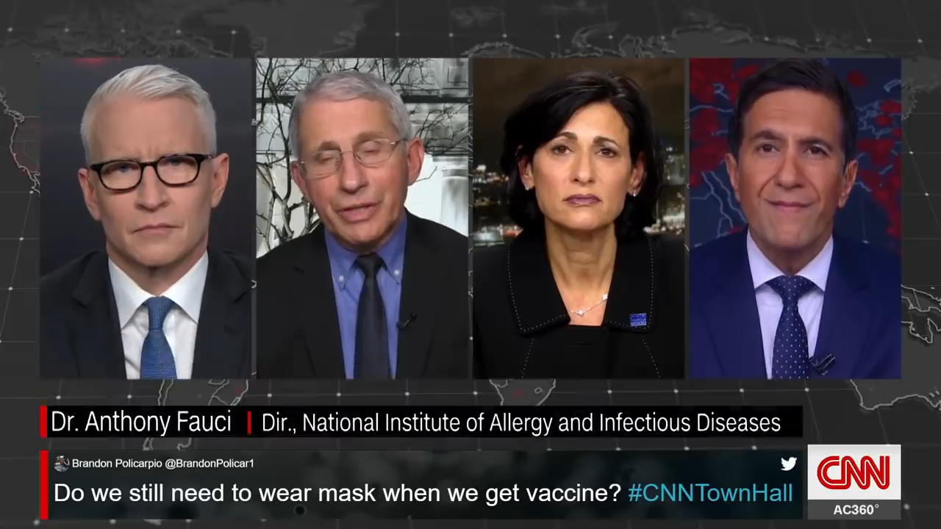
Credibility
Dr. Fauci gave his response to Carole Gardner concerns about immunity. He gives justifiable facts concerning the injections. He stated that citizens were only allowed a degree of immunity after injection. Still, they would have to wait for a maximum of 10 to 15 days to get a degree of immunity. The maximum immunity allowed for persons to travel is ideally ten days to 2 weeks after receiving the second injection, which means that you will have protected yourself from contracting the virus at a 94 to 95 percent rating.

Slide 4
cause effective reasoning
Carole Gardner, who, together with her husband, could not travel to visit their grandchildren for several months because of travel restrictions, apply cause-effect reasoning in figuring out why they should be allowed to travel as they had got the vaccine. Her question was when exactly the government was going to allow them to travel. Persons who have already had the injection believe that they should have full immunity to travel as they wish because they are immune to the virus

Slide 5
argument from analogy
Dr. Fauci argues from analogy when he made it clear to Citizens that it was in their best interest to continue wearing masks after vaccination even though they have reservations about doing so.

Slide 6
The argument is convincing
both Dr. Fauci and Dr. Rochele presented strong arguments against traveling during this time. a person who has been vaccinated can carry the virus and spread Covid-19 without their knowledge. I believe travel at this time poses a great danger in increasing new infections.
The idea of travel continues to be a sensitive topic to most Americans because traveling locally or internationally has been affected by the pandemic for nearly a year now.

Slide 7
conclusion
The clip is convincing, not travelling during the pandemic is similar to saving lives. people ought to adhere to medics advise on covid19 protective measures.

Slide 8
References
Video link: https://youtu.be/Kd0RGjL-02s, 2021. [video].

